Slide 1
South East Europe 2020
Towards a Regional Growth Strategy
January 2013

Slide 2
How it all begun…
Emergence of multiple regional cooperation frameworks requiring coherence & coordination
Need to anchor reform efforts into an overarching growth and development agenda
Provide RCC with a mandate to perform its role to its fullest potential

Slide 3
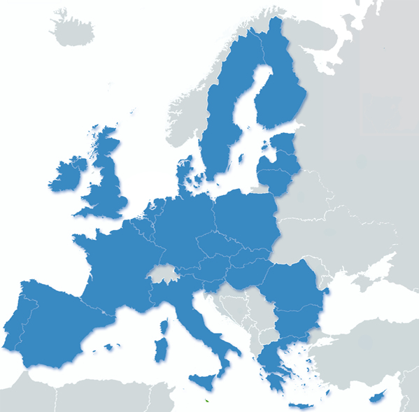
…with kick-start by Europe 2020
Materialized as a response to Europe 2020, as the region was left out of the main European growth framework:
Preparations for future membership suggest that the Europe 2020 policy goals and implementation methods are pertinent to enlargement countries
However, a strong need to adjust the strategy to region’s needs, making it more realistic and credible
Main objectives include boosting competitiveness, productivity, growth potential, social cohesion and economic convergence.
?

Slide 4
Getting the mandate
“The [European] Commission will propose to the Regional Cooperation Council that it sets up platforms for dialogue and peer review in other areas in line with Europe 2020 priorities”
Enlargement Strategy 2010-2011
SEE 2020
RCC to provide a “link between the national and regional level and … for the efforts going into Europe 2020 implementation in the region to demonstrate a considerable level of complementarity with the work being done at the national level.”
Montenegrin C-i-O SEECP
Actively pursue “a regional recovery and development strategy which should follow the main parameters of EU 2020, based on knowledge and innovation.”
June 2010 Sarajevo High Level Mtg

Slide 5
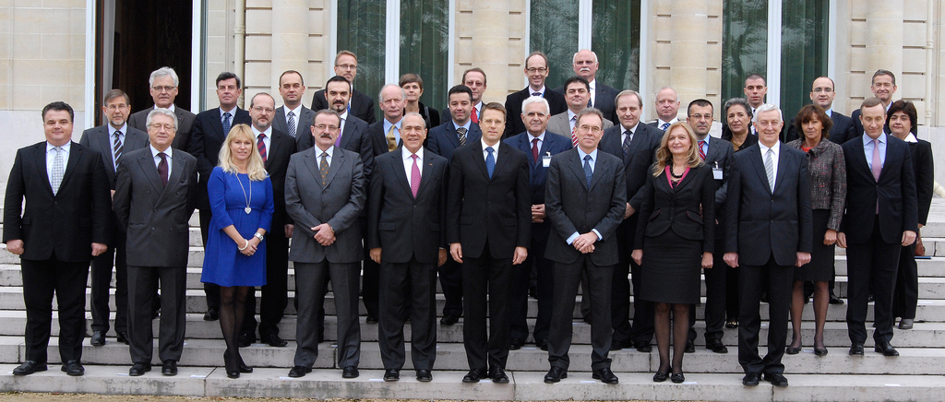
SEE Investment Committee – SEE2020 Catalyst
  Transfer of SEEIC provided an opportunity to:
  Get a clear mandate for SEE2020 Development
  Engage national administrations
  Secure resources

Slide 6
Integrated growth
deeper regional trade and investment linkages and policies enhancing the flow of goods, investment, services and persons
Smart growth
commitment to compete on value added, promoting knowledge and innovation across the board
Inclusive growth
skills development, employment creation and labour market participation by all, including vulnerable groups and minorities
SEE 2020
Vision
Sustainable growth
enhancing competitiveness, entrepre-neurship and a commitment to greener and more energy-efficient development
Governance for growth
improving the capacity of public administrations to strengthen the rule of law and reduce corruption so as to create a business-friendly environment

Slide 7
Formulating SEE 2020
Identify priorities
  integrated, smart, sustainable, inclusive growth within good governance framework
Determine appropriate policy areas for setting objectives and targets
  e.g. trade as an area that best captures integrated growth
Formulate appropriate objectives
  e.g. increase intra-regional trade as an objective of integrated growth
Determine baseline data for objectives
  e.g. currently intra-regional trade (goods) amounts to EUR 12.5 billion
Establish strategic intent (target)
  e.g. increase intra-regional trade by 240% by 2020
Put forward indication of measures/actions and indicators
  e.g. removal of NTBs and greater facilitation of trade; fostering of regional value chains to boost movement of goods/services accross borders etc.

Slide 8
Milestones
November 2013: SEE Ministers endorse strategy and governance mechanism
October 2012: SEEIC approves targets
July - Sep 2012: SEE Task Force meets to develop targets
2013
Dec 12 – Nov 13:
Strategy & Action plan development & governance proposal
November 2011: SEE Vision adopted by the Ministers
2012
November2012: SEE Ministers endorse targets
2011
April 2012: SEEIC sets-up a Task Force to look into targets

Slide 9
Milestones:
Vision, Mandate, Resources
November 2013: SEE Ministers endorse strategy and governance mechanism
Done:
Vision: Integrated, smart, sustainable and inclusive growth, underpinned by good governance
Mandate for RCC to engage with SEE 2020 and use SEEIC as the main instrument (transfer)
Resources to initiate the work
October 2012: SEEIC approves targets
July - Sep 2012: SEE Task Force meets to develop targets
2013
2013
Dec 12 – Nov 13:
Strategy & Action plan development & governance proposal
November 2011: SEE Vision adopted by the Ministers
2012
2012
November2012: SEE Ministers endorse targets
2011
2011
April 2012: SEEIC sets-up a Task Force to look into targets

Slide 10
Milestones:
Refocusing and restructuring SEEIC
November 2013: SEE Ministers endorse strategy and governance mechanism
October 2012: SEEIC approves targets
July - Sep 2012: SEE Task Force meets to develop targets
Done:
Positioned the SEEIC as the main regional champion of SEE 2020
Reshaped the structure of SEEIC to better reflect the needs of the process
Initiated target-setting for SEE 2020 and set up a Task Force on SEE 2020
2013
2013
Dec 12 – Nov 13:
Strategy & Action plan development & governance proposal
November 2011: SEE Vision adopted by the Ministers
2012
2012
November2012: SEE Ministers endorse targets
2011
2011
April 2012: SEEIC sets-up a Task Force to look into targets

Slide 11
Milestones:
Target-setting
November 2013: SEE Ministers endorse strategy and governance mechanism
October 2012: SEEIC approves targets
Done:
Two meetings held to (i) identify appropriate policy areas for setting targets, (ii) establish baseline and (iii) determine targets
11 regional headline targets determined with corresponding 77 national targets
July - Sep 2012: SEE Task Force meets to develop targets
2013
2013
Dec 12 – Nov 13:
Strategy & Action plan development & governance proposal
November 2011: SEE Vision adopted by the Ministers
2012
2012
November2012: SEE Ministers endorse targets
2011
2011
April 2012: SEEIC sets-up a Task Force to look into targets

Slide 12
Milestones:
Target-setting and buy-in
November 2013: SEE Ministers endorse strategy and governance mechanism
Done:
9 out of 11 proposals for targets endorsed, with further two (tertiary education and enterprise creation) currently under review
Draft Ministerial statement reviewed and endorsed after amendments
October 2012: SEEIC approves targets
July - Sep 2012: SEE Task Force meets to develop targets
2013
2013
Dec 12 – Nov 13:
Strategy & Action plan development & governance proposal
November 2011: SEE Vision adopted by the Ministers
2012
2012
November2012: SEE Ministers endorse targets
2011
2011
April 2012: SEEIC sets-up a Task Force to look into targets

Slide 13
Milestones:
Political commitments
November 2013: SEE Ministers endorse strategy and governance mechanism
Done:
Adoption of targets
Mandate for strategy development and monitoring and governance
October 2012: SEEIC approves targets
July - Sep 2012: SEE Task Force meets to develop targets
2013
2013
Dec 12 – Nov 13:
Strategy & Action plan development & governance proposal
November 2011: SEE Vision adopted by the Ministers
2012
2012
November2012: SEE Ministers endorse targets
2011
2011
April 2012: SEEIC sets-up a Task Force to look into targets

Slide 14
Milestones:
Targets set
Description | 2010 | 2020
Overall strategic goals
1. Increase of GDP PPP per cap relative to the EU (% of EU 27 GDP PPP p/c avg) | 38.4 | 45.9
2. Growth of Total Trade in Goods and Services (in EUR million) | 89,884 | 212,520
3. Reduction of Trade Deficit /Improvement of Trade Balance | -14.1 | -11.6
Integrated growth
4. Growth of intra-regional trade in goods (in million EUR) | 12,507 | 42,120
5. Growth of Overall FDI Inflows (in current EUR million) | 3,334 | 7,527
Smart Growth
6. Growth of GDP per Person Employed (in EUR) | 18,371 | 24,462
Sustainable Growth
7. Growth of enterprise creation | 30,107 | 36,100
8. Growth of Exports of Goods and Services per capita (in EUR) | 1,844 | 4,221
Inclusive Growth
9. Growth of Overall Employment Rate (per cent of 15+) | 40.2 | 45.2
10. Increase Population With Tertiary Education Within the Regional Workforce | 1.7 mil. | 2 million
Governance for Growth
11. Increase Government Effectiveness (as measured by WBI indicator) | 2.33 | 2.80

Slide 15
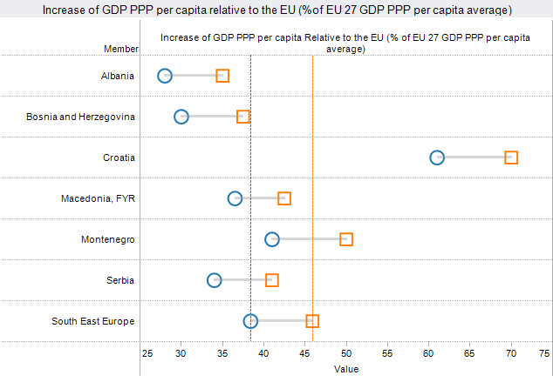
Select SEE 2020 targets:
Convergence
2010
2020

Slide 16
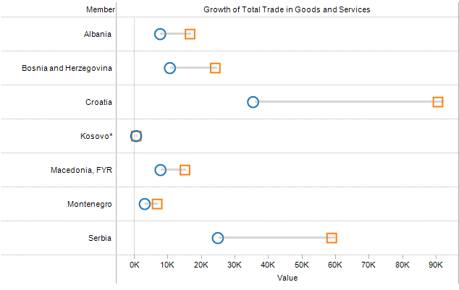
Select SEE 2020 targets:
Total trade
in mil EUR
2010
2020

Slide 17
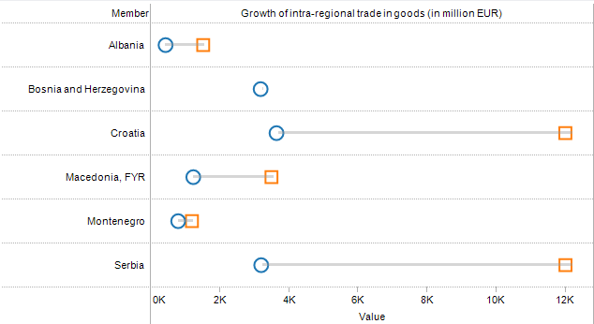
Select SEE 2020 targets:
Intra-regional trade
in mil EUR
2010
2020

Slide 18
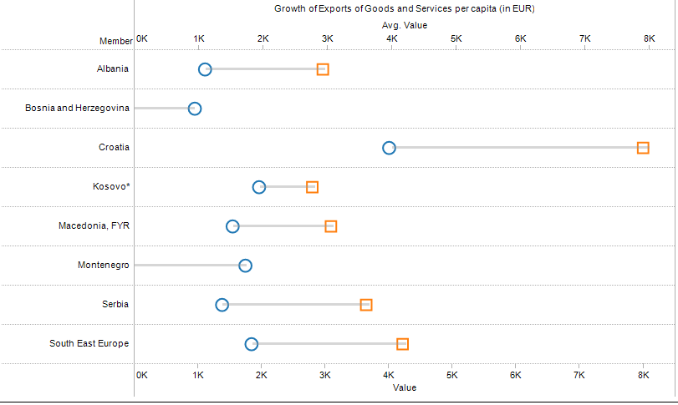
Select SEE 2020 targets:
Exports per capita
in mil EUR
2010
2020

Slide 19
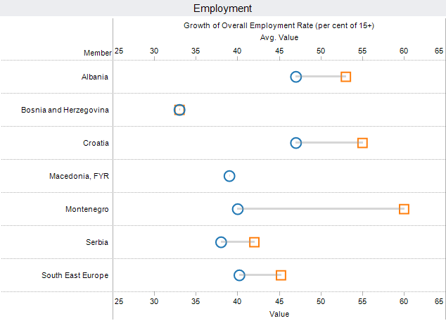
Select SEE 2020 targets:
Employment rate
2010
2020

Slide 20
Milestones:
Strategy and Action Plan Development
November 2013: SEE Ministers endorse strategy and governance mechanism
To Be Done:
Strategy and Action Plan development by Nov 2013
October 2012: SEEIC approves targets
July - Sep 2012: SEE Task Force meets to develop targets
2013
2013
Dec 12 – Nov 13:
Strategy & Action plan development & governance proposal
November 2011: SEE Vision adopted by the Ministers
2012
2012
November2012: SEE Ministers endorse targets
2011
2011
April 2012: SEEIC sets-up a Task Force to look into targets

Slide 21
SEE 2020 Development Process
A distributed approach:
Divest development of SEE 2020 to regional structures that:
  Are able to play a leading role within each pillar
  Are functionally aligned with SEE 2020
  Have capacity to work on development and can build capacity for implementation
  Have, or are willing to put in place adequate governance mechanisms
Coordinate development of joint objectives, actions and indicators at the regional level
Verify through national administrations (shaping governance)
Coordinate at RCC level

Slide 22
Proposal for de-centralized development
(Example: Integrated growth pillar)
RCC
Regional structure
National administration
(Distributes responsibility for trade and investment policy)
Integrated growth
CEFTA
(Trade)
SEEIC (investment)
Line Ministry
SEE 2020 Strategy and Action Plan
Advisor
National development strategies
(a) 2nd tier objectives
(b) measures and actions
(c) indicators
(d) budgets
CEFTA Joint Committee/SEEIC Ministerial

Slide 23
Envisioned implementation
Establish strong links between national priorities (national development strategies, Economic and Fiscal Programmes, Pre-Accession Economic Programmes, etc.) and regional targets
Disaggregated national and regional targets and objectives to provide clear frameworks for action
Put forward a monitoring framework and a governance mechanism
Regional platforms provide progress review with overall coordination and monitoring at RCC level

Slide 24
De-centralized dev’t & implementation
SEEIC
CEFTA
ERI SEE
pillar: integrated growth
JHA
Strat
EDIF
e-SEE
Parliament
pillar: governance
pillar:
smart growth
SEECP
R&D Strat
RCC
SEE 2020
pillar: inclusive growth
pillar: sustainable growth
RENA
Social Agenda
SEETO
ECS

Slide 25
If done correctly, SEE 2020 provides…
A clear framework with identified strategic targets, indicators and measures to guide cooperation, consistent with national priorities
Governance framework for cooperation and coordination on policy responses to issues that cross national borders
Framework for interaction with donors engaged in regional interventions and coordination with national IPA programmes

Slide 26
…with clear benefits for regional cooperation as well
Unambiguous roles of stakeholders in regional cooperation
Fully streamlined activities of regional players
Clear monitoring mandate with pre-defined indicators and agreement with regional structures and national administrations
Strong focus

Slide 27
Key points for consideration
Putting forward appropriate governance mechanisms and incentives
Coupling commitments with tools to reach objectives
Intra-governmental coordination within the SEE administrations

Slide 28



Overview of SEE 2020 Pillars

Slide 29
i. Integrated growth:
Targets and priority actions
1. Increase intra-regional trade in goods by more than 230%
2. Increase overall FDI inflows to the region by at least 120%
Removing trade distortive non-tariff barriers and facilitating cross-border movement of goods in a timely fashion;
Undertaking concerted efforts for the liberalisation of trade in services, under the auspices of CEFTA;
Creating a regional strategy for investment promotion that builds on the work that has already been conducted by the regional working groups under the auspices of the Investment Compact and the SEEIC;
Enforcing laws and regulations to protect intellectual property;
Supporting the work of all CEFTA bodies and structures to fulfill their respective mandates; and
Developing a single regional capital market.

Slide 30
i. Integrated growth:
Main stakeholders
Main regional platforms:
SEE Investment Committee
CEFTA
National counterparts:
Ministries and agencies in charge of trade and investment
Main partners:
OECD
IFC
Regional expert networks

Slide 31
ii. Smart growth:
Targets and priority actions
    Increase GDP per person employed by 33%
Promoting „triple helix‟ linkages between academia, industry and policy makers;
Promoting free flows of talent in the region by encouraging SEE economies in achieving bilateral/multilateral universal recognition of diplomas and abolishment of unnecessary visas and permits for students, academia and the business community;
Encouraging “brain gain” through targeted networking with the diaspora and creating conditions favorable to eventual return, in particular through the establishment of a supportive entrepreneurial environment;
Supporting private and public sector investment in R&D via coherent and regionally co-ordinated policies to enhance innovation and promote the knowledge economy and society;

Slide 32
ii. Smart growth:
Targets and priority actions (continued)
    Increase GDP per person employed by 33%
Facilitating the participation of enterprises and scientific institutions from SEE in EU programmes and EUREKA and developing effective linkages with European institutions fostering innovation and knowledge;
Raising the level of knowledge absorption via policies that support existing clusters, networks, and centres of excellence to establish a regional cooperation framework fostering knowledge communities;
Promoting natural science, maths and engineering studies while enhancing the quality of education provision and existing quality assurance mechanisms;
Using available resources and private sector expertise to substantially increase the level of combined public-private sector investment in R&D as a percentage of GDP;
Considering measures to support business investment in R&D.

Slide 33
ii. Smart growth:
Main stakeholders
Main regional platforms:
ERI SEE
Enterprise Development and Innovation Facility (EDIF)
Regional R&D Strategy for Innovation in the Western Balkans
South East European Centre for Entrepreneurial Learning (SEECEL)
eSEE Initiative and bSEE Task Force
RCC Task Force on culture and society
National counterparts:
Ministries and agencies in charge of science, education, research, economy and finance
Main partners:
OECD
World Bank
ETF
Regional expert networks

Slide 34
iii. Sustainable growth:
Targets and priority actions
Increase the rate of enterprise creation by 20%
Increase exports of goods and services per capita by 130%
Diversifying export markets, and promoting regional co-operation whenever possible;
Developing measures such as export guarantee schemes to support the private sector;
Supporting private sector competitiveness by helping firms, and in particular SMEs, find niches in which they can be successful in global terms;
Strengthening regional value chains by actively supporting the creation of transnational clusters and business networks;
Promoting venture capital and business angel networks;
Reducing the tax wedge on labour to improve competitiveness;
Accelerating the development of critical infrastructure;
Helping businesses develop and adopt renewable & green technologies;
Encouraging education and training systems to deliver „green‟ and „white‟ skills; and
Integrating green development priorities into long-term policy making, utilising available European and international expertise, and interacting with all stakeholders.

Slide 35
iii. Sustainable growth:
Main stakeholders
Main regional platforms:
SEE Investment Committee
Energy Community Secretariat (ECS)
SEE Transport Observatory (SEETO)
RENA/ECRAN
Regional Environmental Centre for CEE
NALAS
ISIS Programme Secretariat
Int’l Sava River Basin Commission
RRD Standing Working Group (RRDSWG)
National counterparts:
Ministries and agencies in charge of energy, environment, economy, transport and infrastructure
CSOs
Main partners:
World Bank
Regional expert networks
CSO Networks

Slide 36
iv. Inclusive growth:
Targets and priority actions
Increase the overall employment rate to 45.2%
    Add 300,000 highly educated people to the region’s workforce
Monitoring and tracking skills needs at the regional level;
Developing mechanisms for regional dialogue between employers and policy makers on ways to minimise skills gaps and address skills mismatches through customised training and curricula reform;
Raising the attractiveness of vocational training and increasing employment opportunities for younger workers and promoting early contact with the labour market, including through measures for facilitation of school-to-work transitions and removing obstacles to internships;
Promoting in-company training and up-skilling of employees;
Promoting the inclusion and retraining of older workers in the labour market;

Slide 37
iv. Inclusive growth:
Targets and priority actions (continued)
Increase the overall employment rate to 45.2%
    Add 300,000 highly educated people to the region’s workforce
Promoting women‟s employment and entrepreneurship and employment of vulnerable groups, in particular the Roma;
Developing regional strategies to support continuous education and lifelong learning and recognition of non-formal & informal education;
Developing entrepreneurial learning as one priority for education reform;
Increasing high quality tertiary education levels;
Providing opportunities for student exchanges enabling students to study in the region and in OECD countries; and
Reducing the number of individuals who leave school early, with a special focus on students with disabilities, learning disabilities and socio-economic, cultural and/or linguistic disadvantages.

Slide 38
iv. Inclusive growth:
Main stakeholders
Main regional platforms:
Social Agenda 2020
SEE VET Network
Centre of Public Employment Services of SEE Countries (CPESSC)
SEE Trade Union Forum (SEETUF)
Adriatic Region Employers’ Centre (AREC)
SEE Health Network
National counterparts:
Ministries and agencies in charge of social issues, employment, education
Main partners:
World Bank
ETF
Regional expert networks
CSOs

Slide 39
v. Governance for growth:
Targets and priority actions
Increase government effectiveness by 20% by 2020
Supporting the capacities of public administrations to design and implement development policies;
Finding complementarities and synergies with other regional initiatives and mechanisms such as the Western Balkan Investment Framework and the Western Balkan Regional Competitiveness Initiative;
Promoting the effective implementation of existing legislation governing competition, including improvement of judiciary capacities and giving high priority to enforcing the rule of law and anti-corruption measures; and
Responsible fiscal and monetary policies.

Slide 40
v. Governance for growth:
Main stakeholders
Main regional platforms:
Strategic document of the JHA in SEE
RESPA
Centre for eGovernance Development (CeGD)
MARRI
Regional Anticorruption Initiative (RAI)
SEE Prosecutors Advisory Group (SEEPAG), SEE Police Chiefs Association (SEPCA), Secretariat of Police Cooperation Convention
Western Balkans Prosecutors' Network, Sofia
Regional Secretariat for Parliamentary Cooperation in SEE (RSPC SEE)
Cetinje Parliamentary Forum
National counterparts:
Ministries and agencies in charge of JHA, public administration reform
National parliaments
Main partners:
SIGMA
Regional expert networks
Regional CSO networks

Slide 41
Thank you
Sanjin Arifagić
Head of Economic and Social Development Unit
Regional Cooperation Council
e: sanjin.arifagic@rcc.int
www.rcc.int

